Slide 1
Technology Value Stream
Bryan Cabrera CSD380 Module 1.2

Slide 2
Introduction
Technology Value Stream: Is the series of steps required to turn an idea into a functioning product or feature for the end users. *Important to note that the end goal is to do this quickly and as efficiently as possible.
Purpose: A more streamlined process that decreases any unnecessary steps.
Importance in DevOps: DevOps practices aim to optimize the technology value stream by automating steps and improving collaboration between development and other necessary teams. This ends up resulting in a more reliable deployment process.

Slide 3
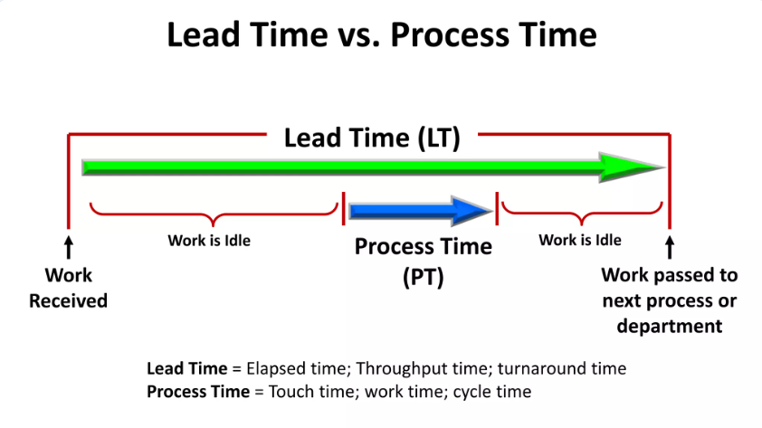
Defining Lead Time vs Processing Time
Lead Time: The total time from the request of a feature to delivery, then to production.
Processing Time: The actual work time involved in development and deployment of said feature.
Example:

Slide 4
Technology Value Stream Process
Discover the concept
Design the idea
Develop the feature via programming
Testing to ensure quality
Deployment

Slide 5
Common Scenario: Deployment Lead Times Requiring Months
Challenges: -Teams being separated can lead to communication delays/errors
-Poor communication can lead to slow progression in each phase of the process
-Poor communication can lead to incorrect changes being made
Result: -Above challenges end up resulting in Lead Times that are incredibly long with some lasting months if not years

Slide 6
Our DevOps Ideal: Deployment Lead Times of Minutes
Improvements: -Cross functional teams with more efficient communication
-Continuous improvements/feedback from internal stakeholders
-The use of automation in testing, integration, and deployment phases
-The use of cloud services for scalability if needed
Result: -The above improvements result in greatly improved Lead Times. Where Lead Times would have originally been months if not years can end up being days if not minutes

Slide 7
Key DevOps Practices
Continuous Integration and Continuous Delivery (CI/CD): -Approach where all developers work on a central code repository
Version Control: -The practice of managing code in versions and tracking any revisions and change history to make the code easier for review
Agile Software Development: -Software development approach that places importance on team collaboration and user feedback
Infrastructure as Code: -Method of managing IT infrastructure using code instead of manual changes therefore automating IT processes
Configuration Management: -Managing the state of resources in a system such as servers, VM’s, and databases to ensure consistency in each one
Continuous Monitoring: -Monitoring the performance and health of the entire application stack in order to mitigate issues in real time

Slide 8
Summary: Key Points
It is important for any organization to understand Lead Time and Processing Time as this helps in identifying any potential inefficiencies
Traditional practices can consistently face delays in both Lead Time and Processing Time but this is something that DevOps aims to minimize
The adoption of specific DevOps practices can result in quicker deployment lifecycles and a faster overall technology value stream

Slide 9
Sources
Lean Leadership - Part 3 of 3 | PPT | Free Download
What is DevOps? | Atlassian
Value Streams in Software: A Definition and Detailed Guide
What is DevOps? DevOps Explained | Microsoft Azure

